Slide 1
COMP 4290
Week 3 - Friday

Slide 2
Last time
What did we talk about last time?
Modular arithmetic
Shift ciphers
Transposition ciphers
Substitution ciphers
Started Vigenère cipher

Slide 3
Questions?

Slide 4
Project 1

Slide 5
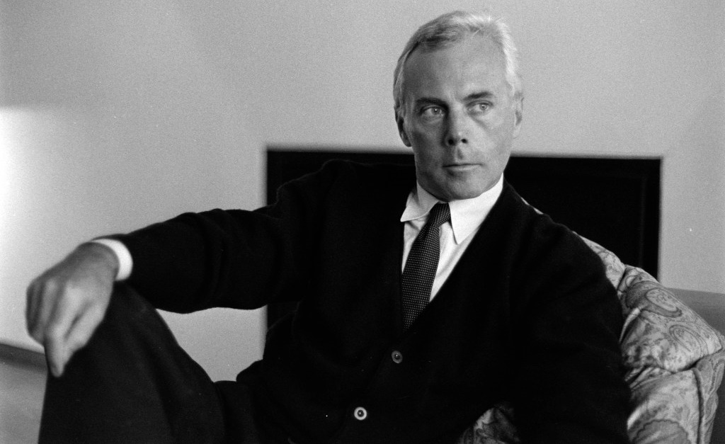
Giorgio Armani
1934 - 2025
Photo Credit: Fairchild Archive

Slide 6
Security tidbit of the day
Cloudflare just defended against the biggest DDoS attack (ever?) over the Labor Day weekend
Cloudflare is a tech company that provides content delivery networks (CDN) and security services to a big chunk of the Internet
The attack is simple: send TONS of bad UDP packets, requiring servers to respond that a service can't be found that matches the UDP
The hard part of doing an attack like this is controlling a large enough botnet to send all the packets
This attack was 11.5 terabits per second
  5.1 billion packets delivered in 35 seconds
  About 60% faster than the previous record-holder of 7.3 terabits per second
The attack targeted one of Cloudflare's clients, but they haven't said who
Follow the story:
  https://www.zdnet.com/article/cloudflare-stops-new-worlds-largest-ddos-attack-over-labor-day-weekend/

Slide 7
Vigenère Cipher

Slide 8
Vigenère cipher
The Vigenère cipher is a form of polyalphabetic substitution cipher
In this cipher, we take a key word and repeat it, over and over, until it is as long as the message
Then, we add the repetitions of keywords to our message mod 26

Slide 9
Vigenère example
Key: BENCH
Plaintext: A LIMERICK PACKS LAUGHS ANATOMICAL
B |  | E | N | C | H | B | E | N | C |  | H | B | E | N | C |  | H | B | E | N | C | H |  | B | E | N | C | H | B | E | N | C | H
A |  | L | I | M | E | R | I | C | K |  | P | A | C | K | S |  | L | A | U | G | H | S |  | A | N | A | T | O | M | I | C | A | L
B |  | P | V | O | L | S | M | P | M |  | W | B | G | X | U |  | S | B | Y | T | J | Z |  | B | R | N | V | V | N | M | P | C | S

Slide 10
Example continued
Encrypt the following:
  Plaintext: GENTLEMEN DINE AFTER SEVEN
  Key: WILDE
Decrypt the following:
  Ciphertext: EOJKINOCQGEOJKI
  Key: BOWIE

Slide 11
Cryptanalysis of Vigenère
The index of coincidence measures the differences in the frequencies in the ciphertext
It is the probability that two randomly chosen letters from the ciphertext are the same
IC =
Period | 1 | 2 | 3 | 4 | 5 | 10 | Large
Expected IC | 0.066 | 0.052 | 0.047 | 0.045 | 0.044 | 0.041 | 0.038

Slide 12
Normalized index of coincidence
Some systems look at a "normalized" index of coincidence, which is found by multiplying the formula given on the previous page by the number of letters in the language
  26 for English
  When reading the literature, both normalized and unnormalized versions can be called index of coincidence
Here are index of coincidence values for a few common languages
Language | Index
English | 1.73
French | 2.02
German | 2.05
Italian | 1.94
Portuguese | 1.94
Russian | 1.76
Spanish | 1.94

Slide 13
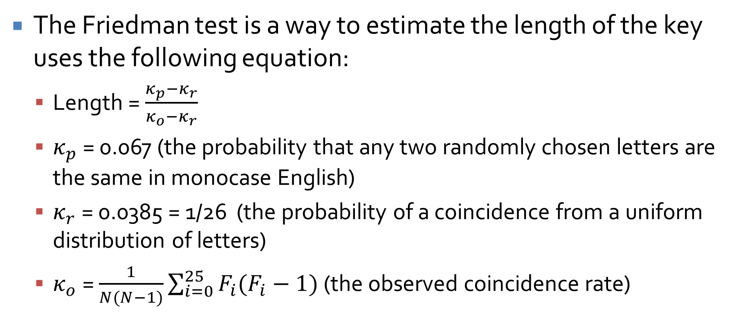
Friedman test
The Friedman test is a way to estimate the length of the key uses the following equation:
  Length = $\frac{κ_{p}−κ_{r}}{κ_{o}−κ_{r}}$
  $κ_{p}$ = 0.067 (the probability that any two randomly chosen letters are the same in monocase English)
  $κ_{r}$ = 0.0385 = 1/26 (the probability of a coincidence from a uniform distribution of letters)
  $κ_{o}$ = $\frac{1}{N(N−1)}\sum_{i=0}^{25}{F_{i}(F_{i}−1)}$ (the observed coincidence rate)

Slide 14
Kasiski method
If the IC indicates that a period of more than 1 is being used, look for repeated sequences
Look at the gaps between long sequences
Try to find the GCD of gaps between long sequences
If you have a reasonable guess for the length of the key, break the ciphertext into groups based on the corresponding letter of the key
If the IC is high (in the range of a single letter), then you have probably found the key length

Slide 15
After the length is known…
The rest is easy
Try various shifts for each letter of the key so that high frequency letters (E, T, A) occur with high frequency and low frequency letters (Q, X, Z) occur with low frequency
Guess and check

Slide 16
One-Time Pad

Slide 17
One-Time Pad
A One-Time Pad is similar to the Vigenère cipher, except that the key is as long as the message
What will this do to the index of coincidence?
Any given ciphertext could be decrypted into any plaintext, provided that you have the right key

Slide 18
One-Time Pad example
Key: THISISTHESECRETPASSWORD
Plaintext: SOMEBODY SHOUTED MCINTYRE
Now, use the key IFYOUDISSDRDRE to encrypt MELODY AND RHYME
S | O | M | E | B | O | D | Y |  | S | H | O | U | T | E | D |  | M | C | I | N | T | Y | R | E
T | H | I | S | I | S | T | H |  | E | S | E | C | R | E | T |  | P | A | S | S | W | O | R | D
L | V | U | W | J | G | W | F |  | W | Z | S | W | K | I | W |  | B | C | A | F | P | M | I | H

Slide 19
One-Time Pad example continued
Plaintext: SOMEBODY SHOUTED MCINTYRE
Find a key (never done that before, have we?) that will encrypt the plaintext to YOUCOULDFINDTHEABSTRACT

Slide 20
Perfect secrecy
A One-Time Pad has the property of perfect secrecy or Shannon secrecy
Perfect secrecy means that P(M) = P(M|C)
  Remember that it is possible to find a key that would decrypt a ciphertext to any plaintext
Thus, learning the ciphertext tells you nothing about the plaintext (except a maximum bound on the length)

Slide 21
One-Time Pad weaknesses
You can only use it one time
  Otherwise, recovering the key is trivial
  Completely vulnerable to known plaintext attack
The key is as long as the message
If you have a way of sending a key that long securely, why not send the message the same way?
Generating keys with appropriate levels of randomness presents a problem

Slide 22
Secure Encryption Algorithms

Slide 23
How do you define good?
Claude Shannon is the guy that invented Shannon secrecy and is considered the father of information theory
He proposed 5 characteristics for a good cipher:
The amount of secrecy needed should determine the amount of labor appropriate for encryption and decryption
The set of keys and the enciphering algorithm should be free from complexity
The implementation of the process should be as simple as possible
Errors in ciphering should not propagate and cause corruption of further information in the message
The size of the enciphered text should be no larger than the text of the original message

Slide 24
A more modern view
Shannon was focused on hand encryption
Modern commercial users of cryptography want the following characteristics for their cryptosystems:
  Based on sound mathematics
  Analyzed by competent experts and found to be sound
  Stood the test of time

Slide 25
Stream and Block Ciphers

Slide 26
Stream and block ciphers
A common way of dividing ciphers is into stream ciphers and block ciphers
Block ciphers divide messages into fixed length parts (or blocks) and encipher each part with the same key
Stream ciphers encipher each message character by character
  Some other authors define a stream cipher to be like a block cipher except that the key changes with each block based on the message

Slide 27
Self-synchronous stream ciphers
Self-synchronous ciphers are stream ciphers that get the key from the message itself
The simplest such cipher is an autokey cipher that uses the message itself for the key
Essentially, this is similar to the Vigenère cipher with the key coming from the message
Example:
  Message: THISISTHEREMIX
  Key: QTHISISTHEREMI
Alternatively, the key can be drawn from the ciphertext
  Message: THEBOYHASTHECAT
  Key: XQXBCQOVVNGNRTT
  Ciphertext: QXBCQOVVNGNRTTM

Slide 28
Confusion and Diffusion
Confusion is the property of a cryptosystem that changing a single character in the plaintext should not have a predictable effect
Diffusion is the property of a cryptosystem that each character in the plaintext should impact many characters in the ciphertext
Examples:
  Caesar cipher has poor confusion and no diffusion
  One time pad has good confusion but no diffusion
  Auto-key ciphers may have poor confusion but good diffusion
  AES and DES have good confusion and diffusion within a block

Slide 29
Ticket out the Door

Slide 30
Upcoming

Slide 31
Next time…
DES
AES
Jennifer Perez presents

Slide 32
Reminders
Keep reading Sections 2.3 and 12.2
Work on Project 1
  Due next Friday
Finish Assignment 1
  Due tonight by midnight!

